Slide 1
Kubernetes Explained
Session 1
Diego Casati, Cloud Solution Architect
Alice Gibbons, Cloud Native Global Black Belt

Slide 2


Who we are
Alice Gibbons
Technical Specialist
Cloud Native Global Black Belt Team
Calgary, Alberta
Diego Protta Casati
Cloud Solution Architect
One Commercial Partner Team
Calgary, Alberta

Slide 3
Kubernetes Explained: 3 Part Series
Session One
Session Two
Session Three
1
2
3
Sept 23, 1-4pm PDT
Docker & Kubernetes Basics
Sept 30, 1-4pm PDT
Azure Kubernetes Service deep dive, Helm & Secrets
Oct 7, 1-4 PDT
Day 2 Operations: Security Monitoring & Scaling
Notes:
Session 1 (Sept. 9)
Basics of containerization/orchestration
Introduction to AKS
Demo example cluster
Kubectl demo
Introduction to the Demo Example Scenario (usable across all 3 workshops)

Slide 4
Agenda
What are Containers? Why Orchestration?
What is Kubernetes?
Pods, Deployments & Services
Deploy in Azure Kubernetes Service
Hands on Labs: Microsoft Learn
Q&A
Notes:
Session 1 (Sept. 9)
Basics of containerization/orchestration
Introduction to AKS
Demo example cluster
Kubectl demo
Introduction to the Demo Example Scenario (usable across all 3 workshops)

Slide 5
But first, let’s talk about …

Slide 6
Containers

Slide 7
What is a container?
A unit of software/deployment
Code
Runtime
System tools
System libraries

Slide 8

What is Docker?
The Company
The Platform
The Tools
Notes:
Docker was initially release in 2013, and was open sourced the same year
The Linux kernel's support for namespaces mostly ^{i}isolates an application's view of the operating environment, including process trees, network, user IDs and mounted file systems, while the linux kernel's cgroups provide resource limiting for memory and CPU
Docker implements a high-level API to provide lightweight containers that run processes in isolation.^{[13]}

Slide 9
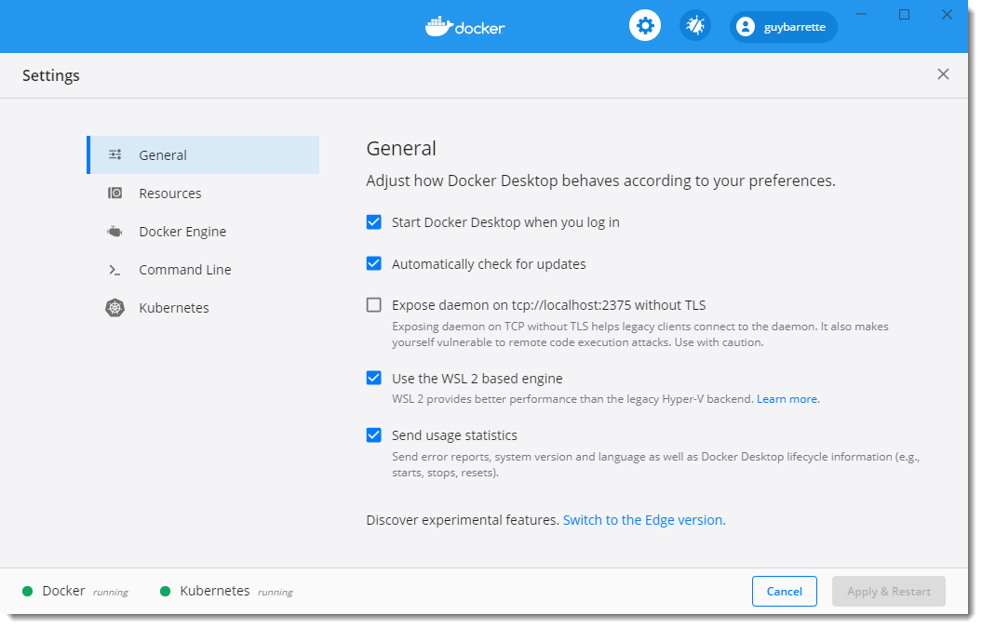
Docker Desktop - Windows

Slide 10
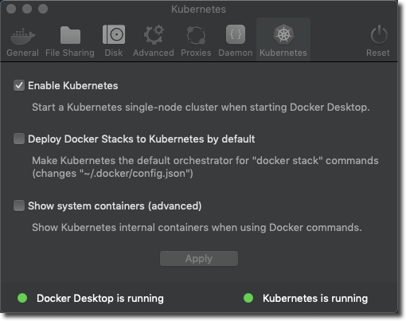
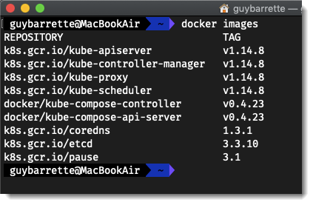
Docker Desktop - Mac
Runs in a LinuxKit VM using the HyperKit lightweight hypervisor

Slide 11
Running Docker locally
Demo 1

Slide 12
Docker (Containers) vs VMs

Slide 13
The container advantage
Traditional virtualized environment
VM
VM
Low utilization of container resources
Application
Con.
Con.
Application
Containerization of applications and their dependencies
Con.
Con.
Hypervisor 2
Host OS
Hardware

Slide 14
The container advantage
Containerized environment
Migrate containers and their dependencies to underutilized VMs for improved density and isolation
VM
VM
Con.
Con.
Decommission unused resources for efficiency gains and cost savings
Con.
Con.
Docker Engine
Host OS
Hardware

Slide 15
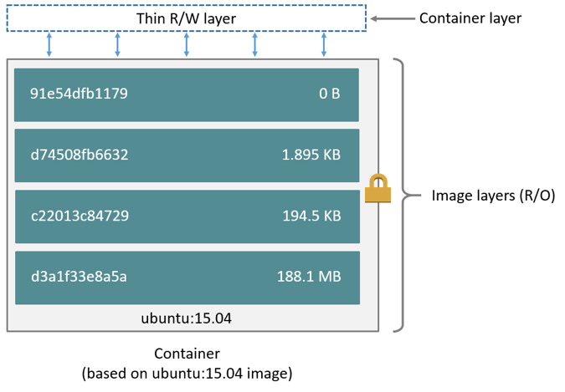
Docker Container Anatomy
Image source: https://docs.docker.com/engine/userguide/storagedriver/imagesandcontainers/#images-and-layers

Slide 16
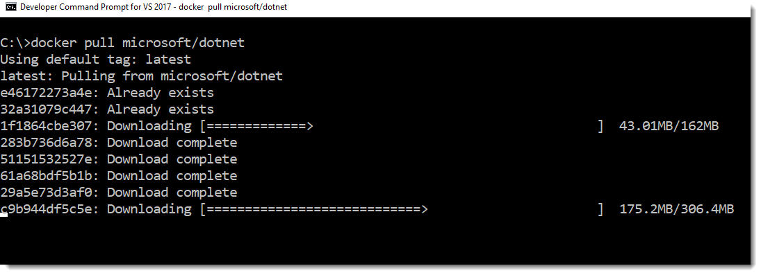
Docker Container Anatomy

Slide 17
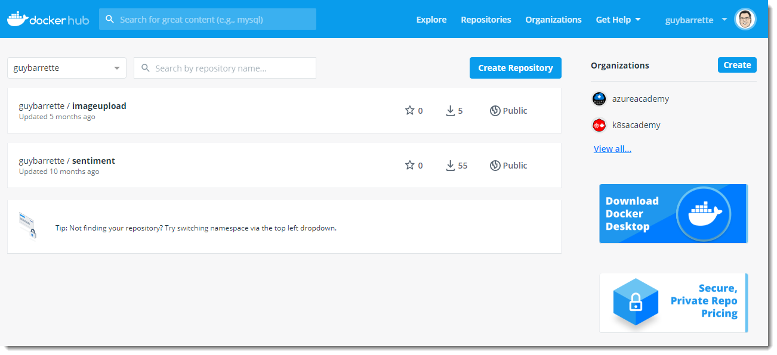
What is a Container Registry?
Centralized container repository
Think GitHub for containers
Docker Hub
https://hub.docker.com/
Azure Container Registry
Managed container registry service based on the open-source Docker Registry 2.0

Slide 18
Pulling and Running an Image
Container local name
# pull and run an nginx server
docker run --publish 8080:80 --name webserver nginx
# list the running containers
docker ps
# stop the container
docker stop webserver
# remove the container
docker rm webserver
Container image in the Docker registry
Maps the host port to the container listening port

Slide 19
Pulling and Running an Image
Demo 2

Slide 20
Anatomy of a Dockerfile
FROM nginx ARG VERSION=0.59.1 ADD https://github.com/gohugoio/hugo/releases/download/v${VERSION}/hugo_${VERSION}_Linux-64bit.tar.gz /hugo.tar.gz
RUN tar -zxvf hugo.tar.gz RUN /hugo version WORKDIR /hugo-site COPY hugo-site . RUN /hugo -v -s /hugo-site -d /usr/share/nginx/html EXPOSE 80
Notes:
Create your own docker containers
Many of the ones online wont suit your needs

Slide 21
Anatomy of a Dockerfile
Our base – from where we should start to build this container
FROM nginx ARG VERSION=0.59.1 ADD https://github.com/gohugoio/hugo/releases/download/v${VERSION}/hugo_${VERSION}_Linux-64bit.tar.gz /hugo.tar.gz
RUN tar -zxvf hugo.tar.gz RUN /hugo version WORKDIR /hugo-site COPY hugo-site . RUN /hugo -v -s /hugo-site -d /usr/share/nginx/html EXPOSE 80
Where are we listening for traffic?
How are we building this ?
Notes:
Custom commands per each dockerfile

Slide 22
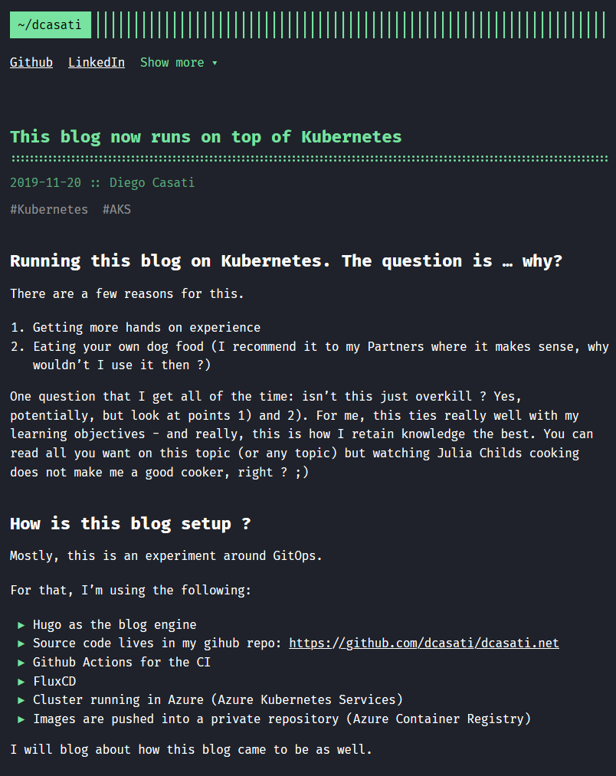
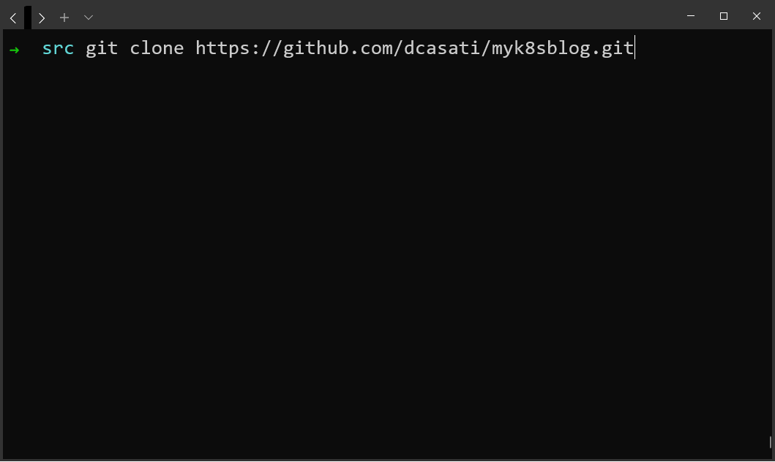
The Application

Slide 23
Dockerfile Creation
Demo 3

Slide 24
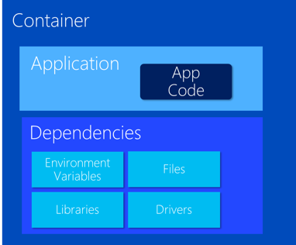
VM Host
VM Host
VM Host
VM Host
But things get
complicated quickly

Slide 25
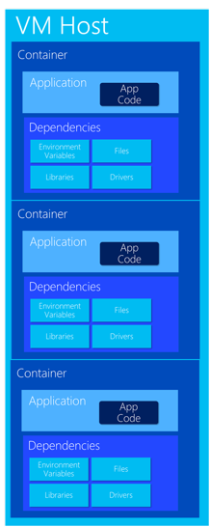
Very Quickly

Slide 26
The elements of orchestration
Scheduling
Affinity/anti-affinity
Health monitoring
Failover
Scaling
Networking
Service discovery
Coordinated app upgrades

Slide 27
Kubernetes: the de-facto orchestrator
Portable
Public, private, hybrid, multi-cloud
Extensible
Modular, pluggable, hookable, composable
Self-healing
Auto-placement, auto-restart, auto-replication, auto-scaling

Slide 28
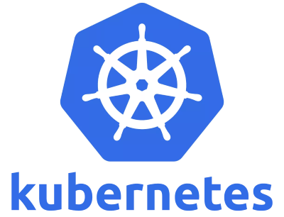
κνβερνητης a.k.a. K8s
Kubernetes
Helmsman in Greek
K8s
K – 8 letters – S
Pronounced like Kate’s
kubernetes.io

Slide 29
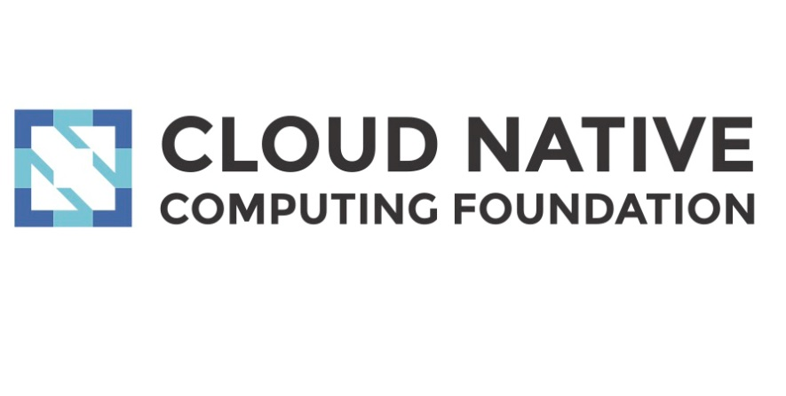
Kubernetes a.k.a. K8s
Originated from Google
v1.0 released on July 2015
3rd gen container scheduler from Google
Previous Google internal projects: Borg and Omega
Donated to the Cloud Native Computing Foundation (CNCF)
www.cncf.io

Slide 30
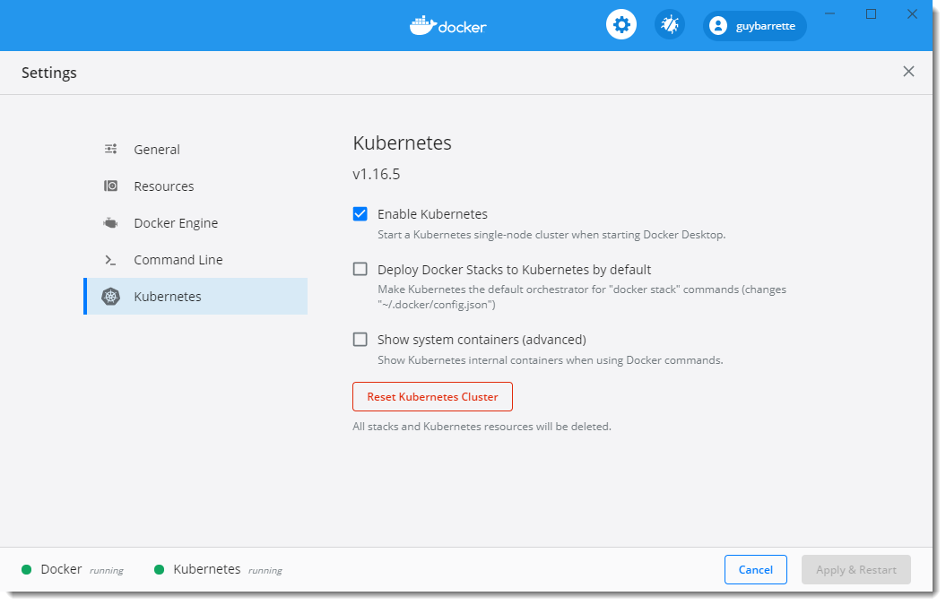
Docker Desktop

Slide 31
Kubernetes 101
Internet
Kubernetes control
Worker node
Kubernetes users communicate with API server and apply desired state
kubelet
kube-proxy
Master node
Docker
Master nodes actively enforce desired state on worker nodes
Prod
Prod
API server
Containers
Containers
Worker nodes support communication between containers
-controller-manager
-scheduler
Worker node
kubelet
kube-proxy
Worker nodes support communication from the Internet
replication, namespace, serviceaccounts, etc.
etcd
Docker
Prod
Prod
Containers
Containers

Slide 32
How managed Kubernetes on Azure works
Automated upgrades, patches
High reliability, availability
Easy, secure cluster scaling
Self-healing
API server monitoring
At no charge
Azure managed control plane
App/ workload definition
Self-managed master node(s)
Kubernetes API endpoint
etcd Store
User
API server
Scheduler
Controller Manager
Cloud Controller
Schedule pods over private tunnel
Customer VMs
Docker
Docker
Docker
Docker
Docker
Pods
Pods
Pods
Pods
Pods

Slide 33
Kubernetes Architecture Components
Where do the Containers go?
Container
Container
Container
App A
App B
App C
Bins/Libs
Bins/Libs
Bins/Libs

Slide 34
Kubernetes Architecture Components
Introducing…. Pods!
Pod
Pod
Pod
Container
Container
Container
App A
App B
App C
Bins/Libs
Bins/Libs
Bins/Libs
Containers go inside Pods!
Notes:
Again since the container provides the virtualization at the OS level we have only the app and its dependencies stored in a container
-

Slide 35
Pods
pod
pod
myk8sblog
aci-connector
port
8080
port
443
pod
core-dns
port
27017
Notes:
Add image name

Slide 36
Pods
Demo 4

Slide 37
Deployment
label
app=myk8sblog, tier=web
image
azurecr.io/myk8sblog:db245a8
pod
myk8sblog1
port
8080
pod
myk8sblog2
port
8080
myk8sblog
Notes:
Pods are great for running a single instance of an app. But that’s not what k8s is good for
The goal is to run multiple replicas of the application, so there you would use deployments
A Deployment provides declarative updates for Pods ReplicaSets.
You describe a desired state in a Deployment, and the Deployment Controller changes the actual state to the desired state at a controlled rate. You can define Deployments to create new ReplicaSets, or to remove existing Deployments and adopt all their resources with new Deployments.
ReplicaSet
A ReplicaSet's purpose is to maintain a stable set of replica Pods running at any given time. As such, it is often used to guarantee the availability of a specified number of identical Pods.

Slide 38
Kubernetes Architecture Components
Cluster
Master
Node
Node
Kube stuff
Kube stuff
Kube stuff
api-server
kubelet
kube-proxy
kubelet
kube-proxy
docker
dns
docker
dns
controller-manager
Pod
myk8sblog1
Pod
myk8sblog2
etcd
scheduler
*Azure Managed
Notes:
Here is what that deployment might look like when it’s deployed to our cluster

Slide 39
Deployments
Demo 5

Slide 40
Deployment
label
app=myk8sblog, tier=web
image
azurecr.io/myk8sblog:db245a8
pod
Service
myk8sblog-1
port
8080
myk8sblog-load-balancer
pod
port
selector
app=myk8sblog
myk8sblog-2
port
80:8080
port
8080
IP
10.0.2.20
myk8sblog
Notes:
Service - An abstract way to expose an application running on a set of Pods as a network service.
With Kubernetes you don't need to modify your application to use an unfamiliar service discovery mechanism. Kubernetes gives Pods their own IP addresses and a single DNS name for a set of Pods, and can load-balance across them.

Slide 41
Kubernetes Architecture Components
Pods
Cluster
Master
Node
Node
Kube stuff
Kube stuff
Kube stuff
api-server
kubelet
kube-proxy
kubelet
kube-proxy
docker
dns
docker
dns
controller-manager
Service
ratings-web
IP Address
Pod
myk8sblog1
Pod
myk8sblog2
etcd
scheduler
*Azure Managed
Notes:
Here’s how a service might be represented in our cluster.
It’s abstract grouping of the pods running ratings-web with its own endpoint which can be used to load balance across the pods

Slide 42
Kubernetes Architecture Components
Pods
Cluster
Master
Node
Node
Kube stuff
Kube stuff
Kube stuff
api-server
kubelet
kube-proxy
kubelet
kube-proxy
docker
dns
docker
dns
controller-manager
Service
ratings-web
IP Address
Pod
myk8sblog1
Pod
myk8sblog2
etcd
scheduler
Pod
foo-1
Pod
bar-1
Pod
foo-2
*Azure Managed
Notes:
And here’s an example of other pods just running outside of the service

Slide 43
Services
Demo 6

Slide 44
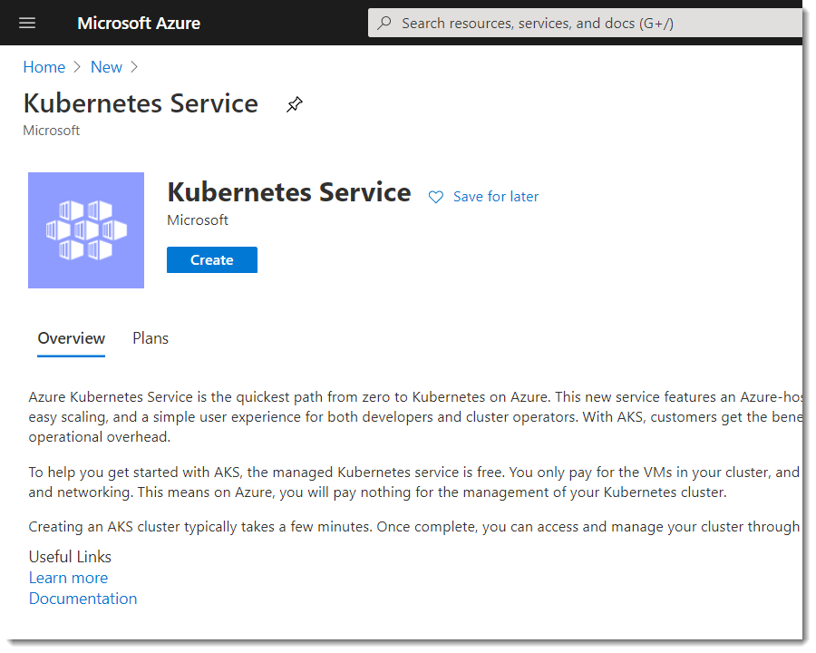

Slide 45
Getting Started with AKS – Start here
How do I create a cluster on Azure ?
az aks create -g myResourceGroup -n myCluster --generate-ssh-keys
How do I install the kubectl ?
az aks install-cli
How do I access my cluster?
$ az aks get-credentials -g myResourceGroup -n myCluster

Slide 46
Deploy in AKS
Demo 7

Slide 47
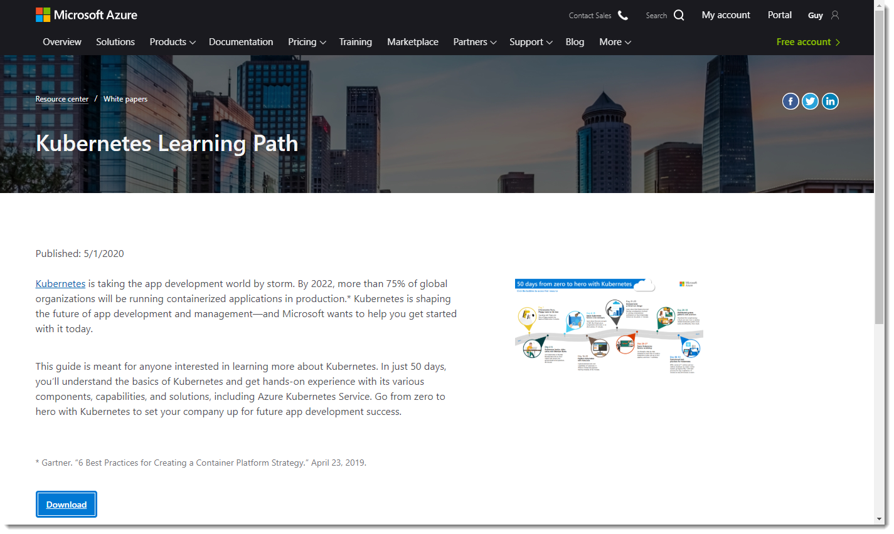
Learn Kubernetes
https://aka.ms/learnkubernetes

Slide 48
Q&A

Slide 49
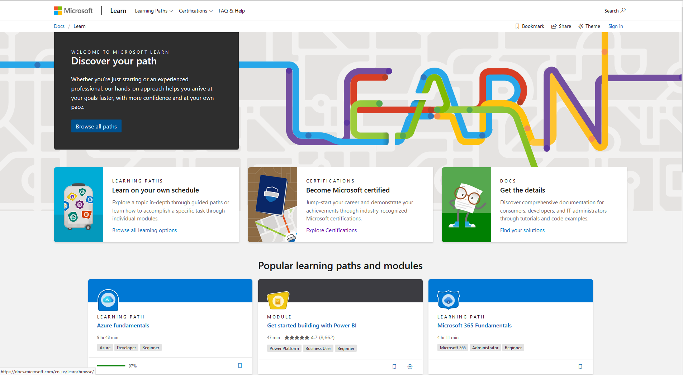

Slide 50
Hands on Content: Modules 1-3
https://aka.ms/kubernetesexplained-1
GitHub Link: Today’s Apps & Slides
https://github.com/alicejgibbons/kubernetes-explained

